Slide 1
Delivering Vaccine Trials at Speed:
The ComFluCOV Experience
A single-blind, phase IV UK multi-centre randomized controlled trial to determine reactogenicity and immunogenicity of COVID-19 vaccines administered concomitantly with seasonal influenza vaccines
Sarah Baos
Rajeka Lazarus
Rachel Todd
Russell Thirard
Jana Kirwan
Katie Joyce
David Hutton
Rosie Harris
Lucy Culliford
Maddie Clout
Heike Cappel-Porter
Chris Rogers
International Clinical Trials Methodology Conference 2022 (Harrogate)

Slide 2
WHY was ComFluCOV designed?
WHY was ComFluCOV designed?
It’s a world-wide pandemic, we need to boost immunity
Another wave is coming, and we are worried about flu you see
We’ve got to jab the population as quick as we can
Co-vaccination seems a possible plan
It’s a world-wide pandemic, we need to boost immunity
Another wave is coming, and we are worried about flu you see
We’ve got to jab the population as quick as we can
Co-vaccination seems a possible plan

Slide 3
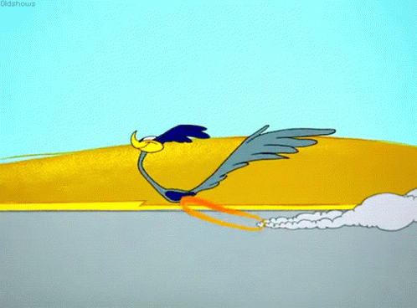
ComFluCOV, a vaccine trial
We all pulled together and delivered in style
Had to deliver in a 10th of the time
So we worked long hours and drank lots of wine

Slide 4
HOW was ComFluCOV delivered?
HOW was ComFluCOV delivered?
It’s a public emergency, so changes were put into place
This allowed things to be approved at double the pace
Knowledge and meta data were shared across CTUs
Co-operation and working double time meant we would never loose
APPROVED
APPROVED

Slide 5
ComFluCOV, a vaccine trial
We all pulled together and delivered in style
Had to deliver in a 10th of the time
So we worked long hours and drank lots of wine

Slide 6
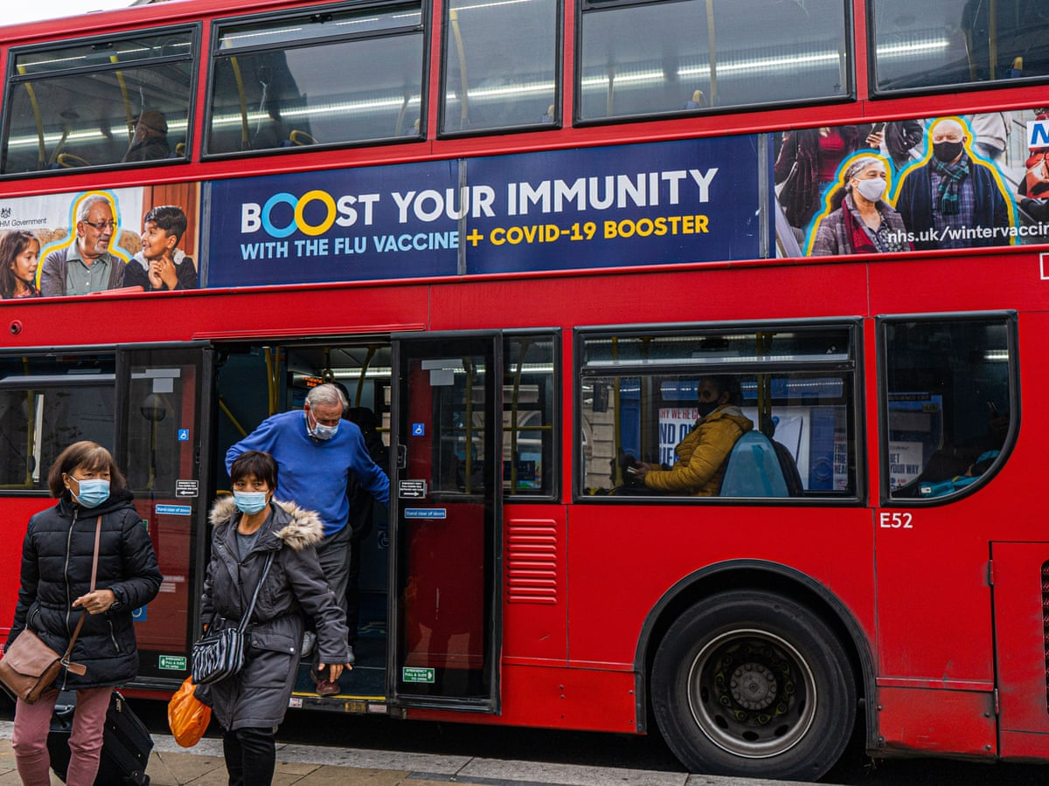
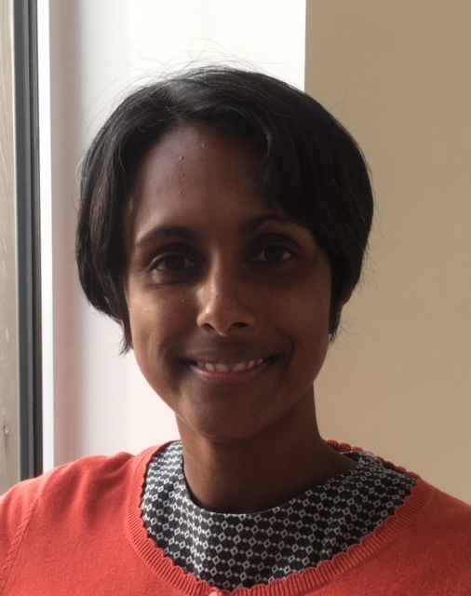
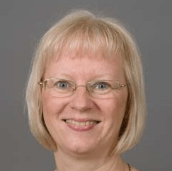
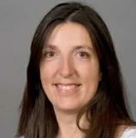
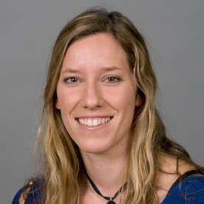
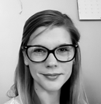
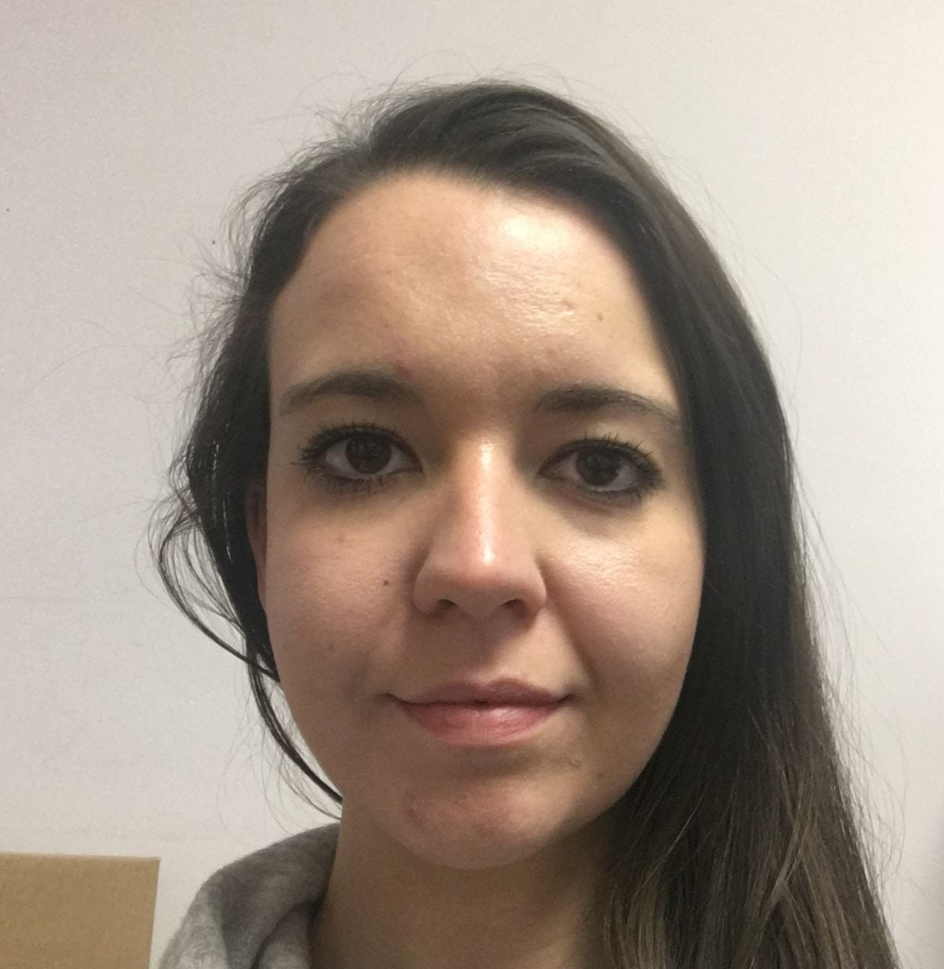
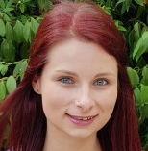
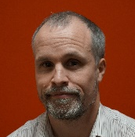
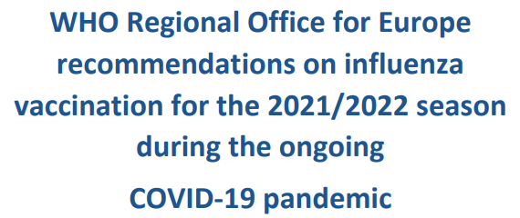
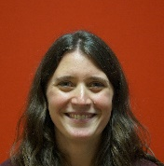
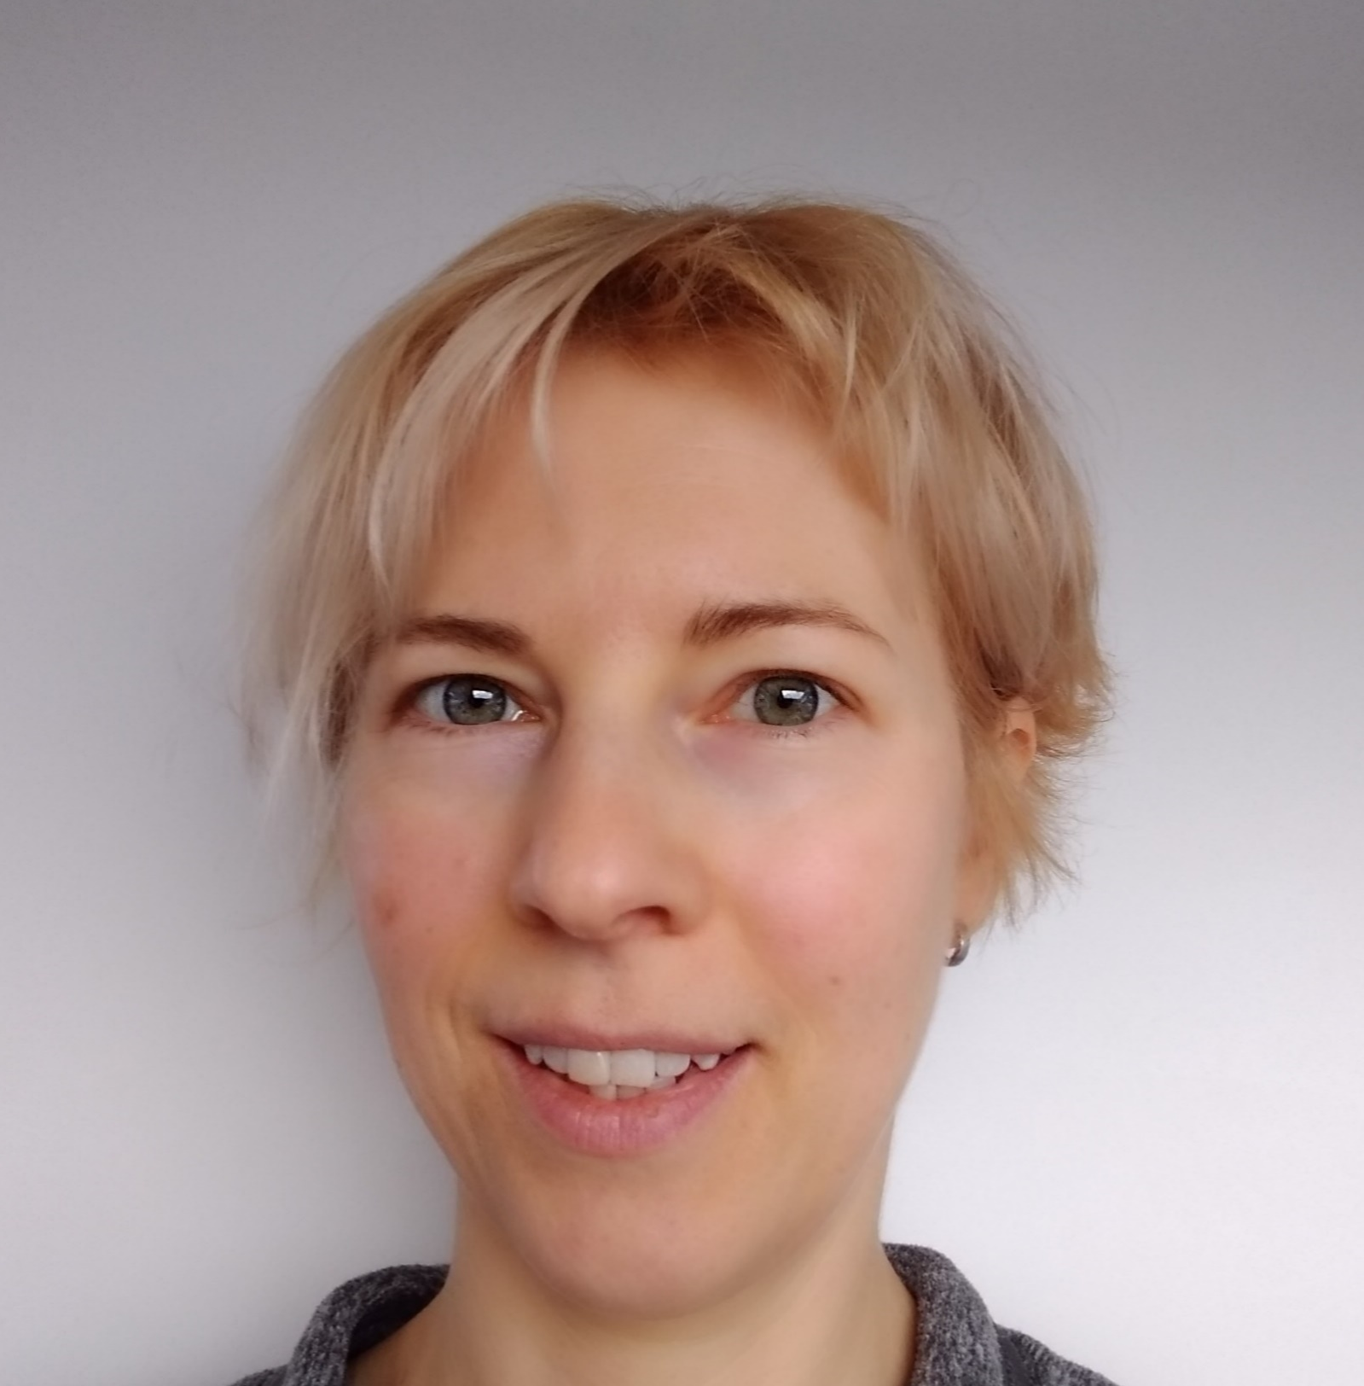
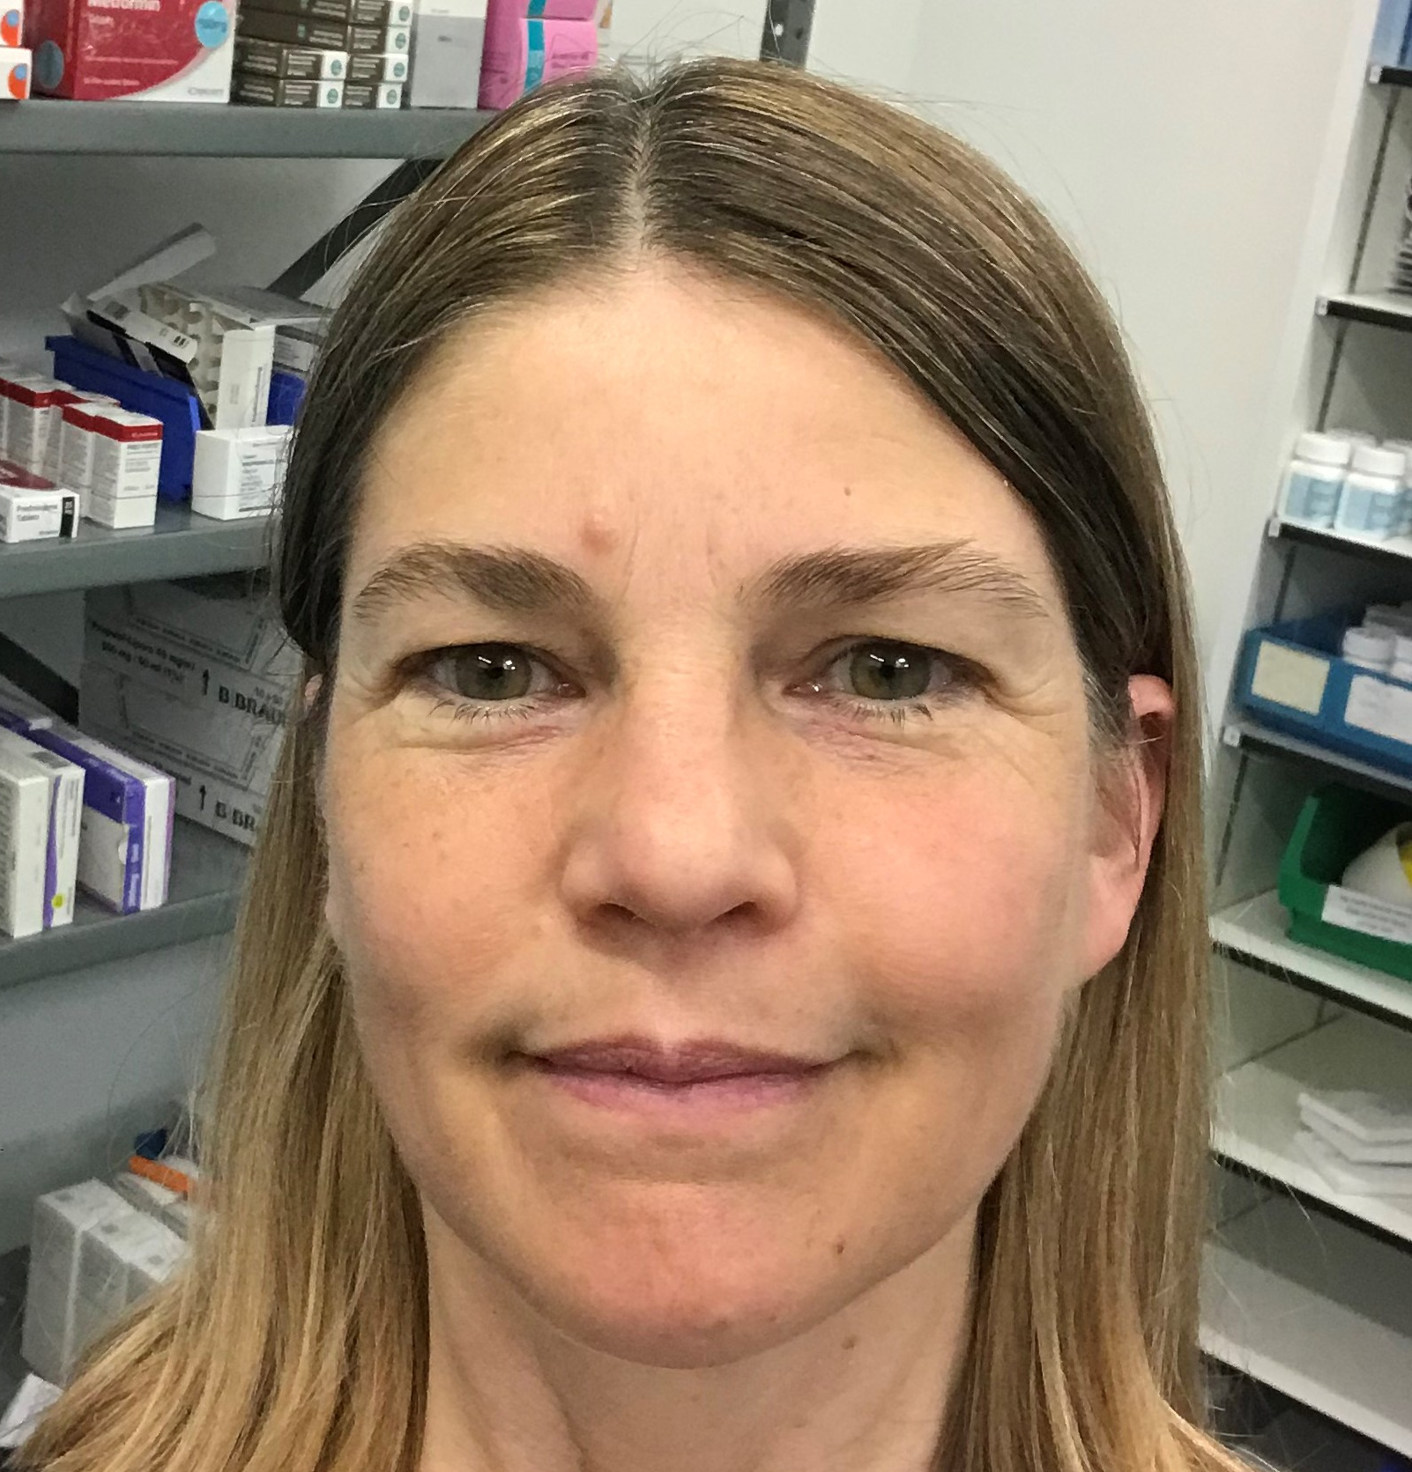
What’s happening NOW?
March 2021
Study conceived
HOW was ComFluCOV delivered?
6 months
The trial was delivered and the vaccines combined
It makes you think, we should we co-operate like this all time
The results have been implemented far and wide
Fills the team with bundles of pride
Sept 2021
Final report
SAFE

Slide 7
ComFluCOV, a vaccine trial
We all pulled together and delivered in style
Had to deliver in a 10th of the time
So we worked long hours and drank lots of wine

Slide 8
A BTC in-house production
Singer-songwriter,
guitarist and producer:
David Hutton
Backing singers:
Rachel Todd & Sarah Baos
Animation:
Sarah Baos
The study is commissioned and funded by the Department of Health and Social Care (DHSC) through the National Institute for Health and Care Research (NIHR). This research was supported by the Vaccine Task Force (VTF) and NIHR Policy Research Programme (PR-R17-0916-22001, NIHR203243). This trial was designed and delivered in collaboration with the Bristol Trials Centre, a UKCRC registered clinical trials unit (CTU) which is in receipt of NIHR CTU support funding, and the NIHR-funded National Immunisation Schedule Evaluation Consortium. The views expressed are those of the author(s) and not necessarily those of the NIHR, VTF or DHSC.

